Slide 1

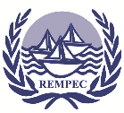

REGIONAL WEBINAR on the Effective Implementation of the Ballast Water Management Convention
Ballast water issue –
where we were, where we are
Dr. Matej David, Dr. Stephan Gollasch
11 November 2025, Webinar

Slide 2
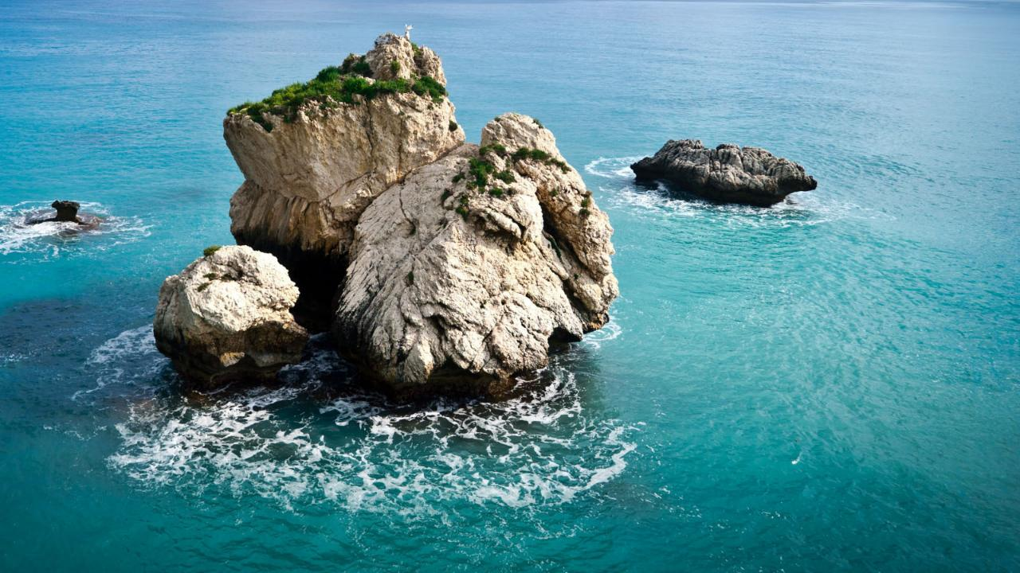

OUTLINE
Species transfer with ballast water
Which organisms are of a threat/unwanted?
Invasions cases/harmful consequences
What is the present situation?

Slide 3

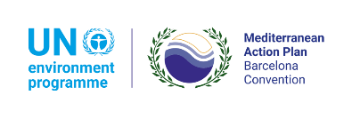


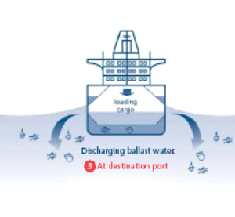
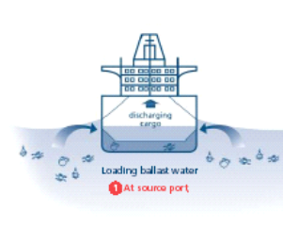
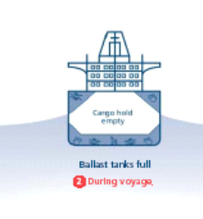
Ballast water on vessels
When a vessel is not fully laden, additional weight is required to compensate for the increased buoyancy that can result in:
the lack of propeller immersion,
inadequate transversal (i.e., heeling) and longitudinal (i.e., trim) inclination,
static and dynamic stresses on the vessel’s hull including shear forces and bending moments, and
static and dynamic transversal and longitudinal stability,
in order to provide for the vessel’s seaworthiness.
This implies that not only commercial vessels, but also other vessels use ballast water to provide for adequate seaworthiness.
GloBallast
Ballast water issue – where we were, where we are

Slide 4

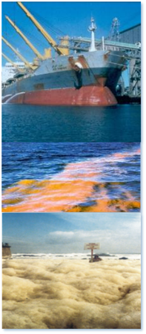
THE ISSUE
Ballast water is one of the main (if not the main) vector of transfer of aquatic organisms that, after being discharged to the environment, cause harm.
Negative effects:
Environmental (e.g., predation, parasitism, competition for food and space, introduction of new pathogens, genetics, alterations of the natural environment)
Economical (e.g., aquaculture, commercial and recreational fishing, tourism, industrial use of water, municipal waterworks and supply of potable water, power plants)
Human health (e.g., cholera, PSP, DSP, faecal and other bacteria)
Ballast water issue – where we were, where we are

Slide 5
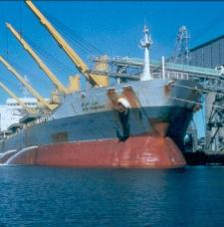
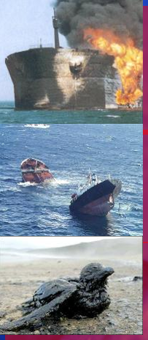
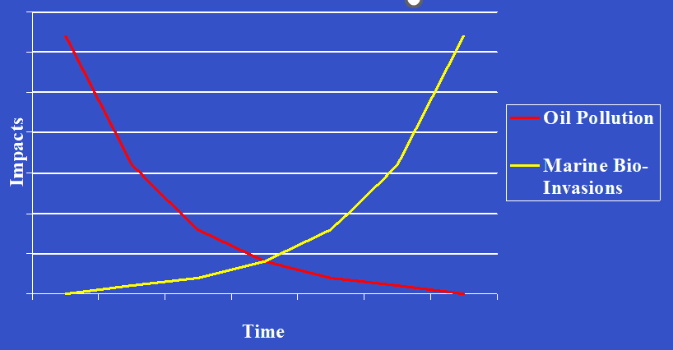
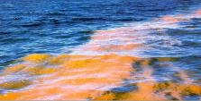
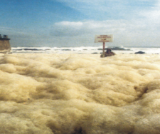
OIL POLLUTION vs BIO-INVASIONS EFFECTS THROUGH TIME:
GloBallast
Bio-invasions – a silent INVADER!
Ballast water issue – where we were, where we are

Slide 6
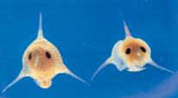
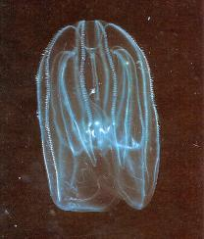
Which organisms are relevant?
Non-indigenous species (NIS)? Invasive alien species (IAS)?
Ballast water is a vector of transfer of Harmful Aquatic Organisms and Pathogens (HAOP) recognised as one of the top human-made pressures on the oceans, seas, rivers and lakes
IMO definition:
HAOP means aquatic organisms or pathogens which, if introduced into the sea including estuaries, or into fresh water courses, may create hazards to the environment, human health, property or resources, impair biological diversity or interfere with other legitimate uses of such areas
HAOP mean/include:
all potentially harmful nonindigenous species (NIS) and or cryptogenic species,
impacting native aquatic species, and
pathogens
Ballast water issue – where we were, where we are

Slide 7
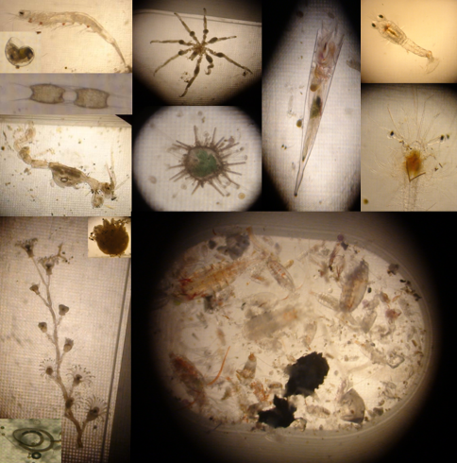
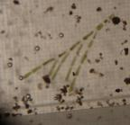
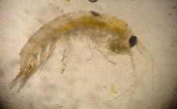
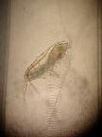
Biology in Ballast Water
Almost all types of organisms were found in ballast tanks before treatment
Unicellular algae to fish
Mostly crustaceans (e.g., copepods, crabs, lobster larvae) and molluscs (e.g., mussels, snails)
Rarely sea urchins and macroalgae
Ballast water issue – where we were, where we are

Slide 8
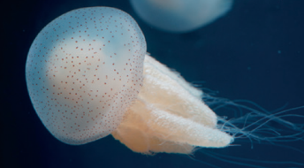
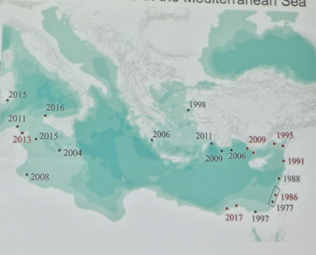
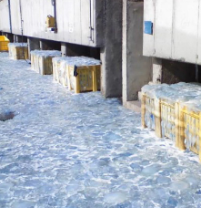
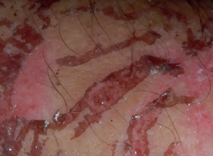
Rhopilema nomadica – the Nomad Jellyfish
(IPBES 2023)
Umbrella size up to 100 cm (larvae much smaller)
Native range: tropical warm waters Indian & Pacific Oceans
Likely vector: Ballast water - also secondary spread (questionable Suez Canal migrant)
1st record in Mediterranean Sea: 1986 in Israel
Impact: zooplankton predator, causing venemous stings to humans, swarm forming, clogging water intakes
(Edelist et al 2020)
(CIESM 2011)
(IPBES 2023)
Ballast water issue – where we were, where we are

Slide 9
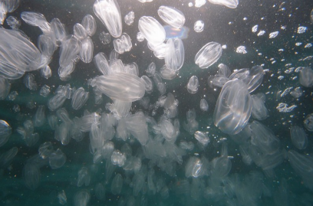
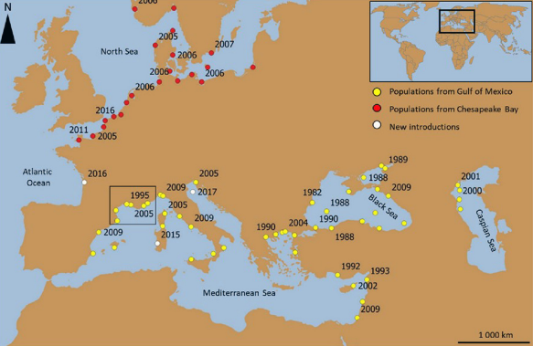
Mnemiopsis leidyi – the Sea Walnut
Size up to 10 cm
Native range: western Atlantic (USA to Argentina)
Likely vector: Ballast water (also for secondary spread)
1st record in Europe in Black Sea early 1980s, 1st in Mediterranean Sea in 1992 in Mersin Bay, Turkey
Impact: Mass developments, zooplankton predator, dramatically reduced fish catch in 1990s in Black Sea with decline and temporarily collapse of fishing industry
(https://misdis.dedide.info/sea-walnuts/)
(Marchessaux 2020)
Ballast water issue – where we were, where we are

Slide 10
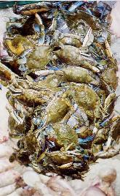
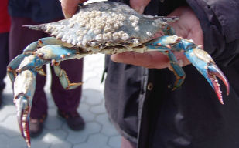
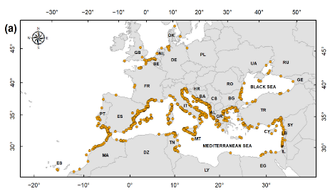
Callinectes sapidus – the Blue Crab
Size up to 23 cm (larvae much smaller)
Native range: western Atlantic (Canada to Argentina)
Likely vector: Ballast water (also for secondary spread)
1st record in Europe in France 1900 in Rochefort, France, 1st in Mediterranean Sea in 1940 in Egypt, (Nehring 2011 & Castriota et al 2024)
Impact: Dominant predator, can regulate benthic species, very strong affect on shellfish industry (Manila clams) in northern Adriatic, in extreme with almost 100 % loss, further expanding
In Mediterranean Sea of commercial value, targeted fisheries established
(Castriota et al 2024)
Ballast water issue – where we were, where we are

Slide 11
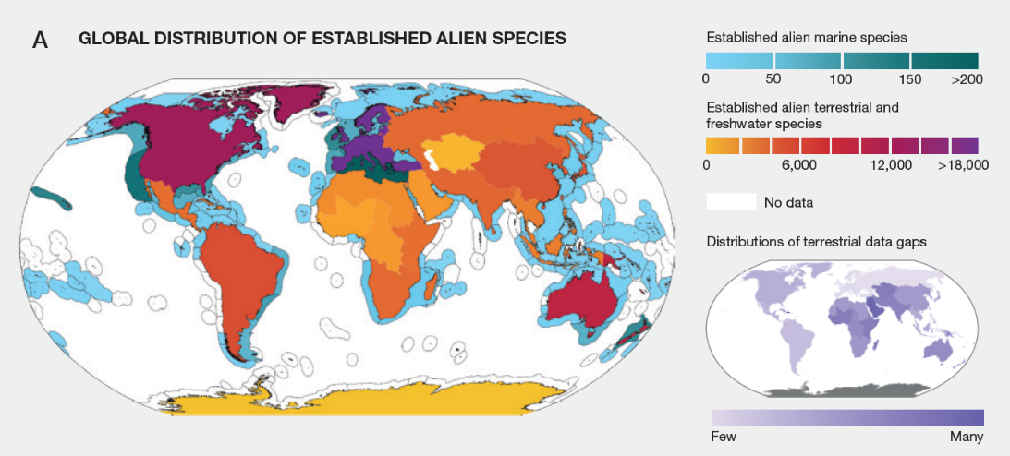

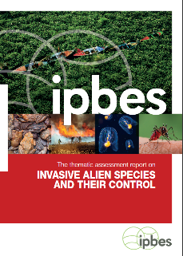
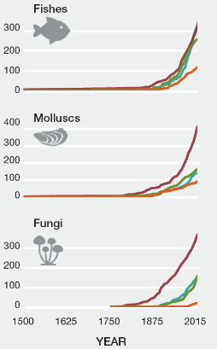

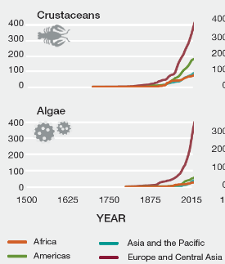

IPBES 2023
Intergovernmental Science-Policy Platform on Biodiversity and Ecosystem Services
Ballast water issue – where we were, where we are

Slide 12
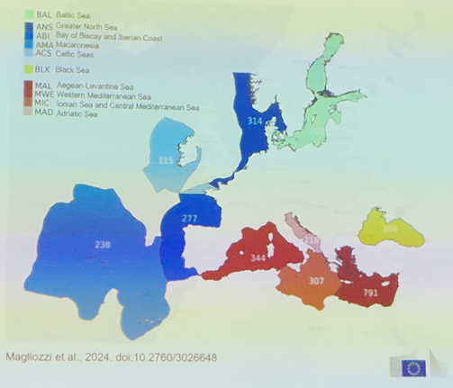
Non-indigenous Species Mediterranean Sea Overview
Mediterranean Sea in total 1006 NIS
Highest number (791 NIS) in Eastern Mediterranea Sea
NE Atlantic (incl. North Sea) 656, Black Sea 266, Baltic 220 NIS
Invasion rate increasing, >10 new NIS per year in Mediterranean Sea (Magliozzi et al 2024)
Globally 13,867 known established NIS
26 % of all known NIS are aquatic
Only 5 % of the global known costs triggered by NIS are from aquatic invasions and 1 % in marine systems (Cuthbert et al 2021)
Ballast water issue – where we were, where we are

Slide 13
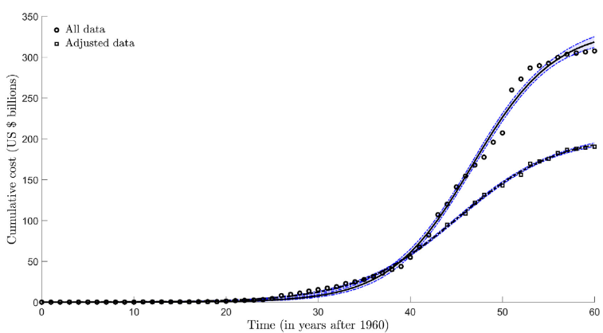
Aquatic NIS Costs
Earlier calculation: Total cost >$345 billion for established aquatic NIS since the 1960s as conservative calculation (Cuthbert et al 2021)
New calculation: Marine NIS costs $4.3 billion since 1975 with $3 billion on damages and $1 billion management
Cost is underestimate as for vast majority of marine NIS cost values are unknown
Costs are exponentially rising (Diagne et al 2021)
Cuthbert et al 2021.
Adjusted data = outliers removed.
Ballast water issue – where we were, where we are

Slide 14
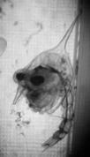
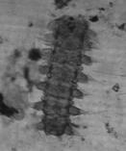
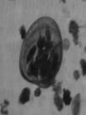
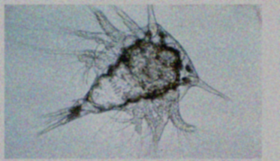
Treatment Survivors
Onboard ballast water treatment is not the perfect solution
After treatment sampling: 247 samples taken during BWMS certification tests on board
“Only” 24 % samples without living organisms
Survivors in high numbers up to several hundreds per 1000 L
Ballast Water Performance Standard D-2 not met in 14 % of samples
15 different taxa survived the treatment
Larvae and adults, mainly crabs, polychaete worms, mussels, cladocerans, barnacles
Some organisms minimum dimension was larger than the filter mesh of BWMS (individuals squeeze through)
Ballast water issue – where we were, where we are

Slide 15
References
Castriota L et al. 2024. When Nature Requires a Resource to Be Used—The Case of Callinectes sapidus: Distribution, Aggregation Patterns, and Spatial Structure in Northwest Europe, the Mediterranean Sea, and Adjacent Waters. Biology 2024, 13(4), 279. https://doi.org/10.3390/biology13040279
CIESM 2011. Jelly blobs are alarm bells of our seas. https://ciesm.org/news/mscience/060711.htm (last assessed 07.11.2025).
Cuthbert RN et al 2021. Global economic costs of aquatic invasive alien species. Science of The Total Environment, 775, 145238. https://doi.org/10.1016/j.scitotenv.2021.145238
Diagne C et al. 2021. High and rising economic costs of biological invasions worldwide. Nature, https://doi.org/10.1038/s41586-021-03405-6.
Edelist D et al. 2020. Phenological shift in swarming patterns of Rhopilema nomadica in the Eastern Mediterranean Sea. J. Plankton Res. 42(2): 211–219. https://doi.org/10.1093/plankt/fbaa008
IPBES 2023. Intergovernmental Science-Policy Platform on Biodiversity and Ecosystem Services
Magliozzi C et al. 2024. Threshold methodology and value for the assessment of Good Environmental Status of D2C1 ‘Newly-introduced non-indigenous species’, Publications Office of the European Union, Luxembourg. JRC139988. https://data.europa.eu/doi/10.2760/3026648
Marchessaux G 2020. How to study the socio-ecological impacts of invasive species: The case of the Ctenophore Mnemiopsis leidyi in Berre Lagoon (southeastern France). Life and Environm. 70(3-4), 149-159. https://www.researchgate.net/publication/354623098_How_to_study_the_social-ecological_impacts_of_invasive_species_the_case_of_the_ctenophore_Mnemiopsis_Leidyi_in_Berre_lagoon_Southeast_France/figures?lo=1
More about BWM:
David, M., Gollasch, S. (Eds.) 2015. Global Maritime Transport and Ballast Water Management – Issues and Solutions. Invading Nature. Springer Series in Invasion Ecology 8, Springer Science + Business Media, Dordrecht, The Netherlands. p. 306. https://doi.org/10.1007/978-94-017-9367-4
David, M., Gollasch, S. (Eds.) 2024. Global Maritime Transport and Ballast Water Management – Issues and Solutions, Second Edition. Invading Nature. Springer Series in Invasion Ecology 8, Springer Science + Business Media, Dordrecht, The Netherlands. p. 306. https://doi.org/10.1007/978-3-031-48193-2
Ballast water issue – where we were, where we are

Slide 16

THANK YOU
Ballast water issue – where we were, where we are

